Slide 1

JavaScript Fundamentals
Course Introduction
SoftUni Team
Technical Trainers
Software University
https://softuni.bg/

Slide 2
Table of Contents
Course Objectives
Training and Team
Course Organization
Course Infrastructure
Evaluation Criteria
2

Slide 3
Have a Question?
sli.do
#fund-js

Slide 4

Course Objectives

Slide 5
Programming Fundamentals Objectives
Working with linear data structures
Arrays
Defining functions and simple classes
Working with objects
Processing and manipulating strings
Regular expressions
5

Slide 6
Practical Programming Exam
Mid Exam
3 practical problems for 4 hours
Conditional Statements and Loops
Linear Data Structures – Arrays
Final Exam
3 practical problems for 4 hours
Associative Arrays
Strings and Text Processing
Regular Expressions
6

Slide 7
Theoretical Exam
You will have 30 minutes once you enter
Multiple choice with 1 or more correct answers
English
Automated quiz system
Available online the day before the practical exam
You can submit your answers just one time
7

Slide 8

The Team

Slide 9
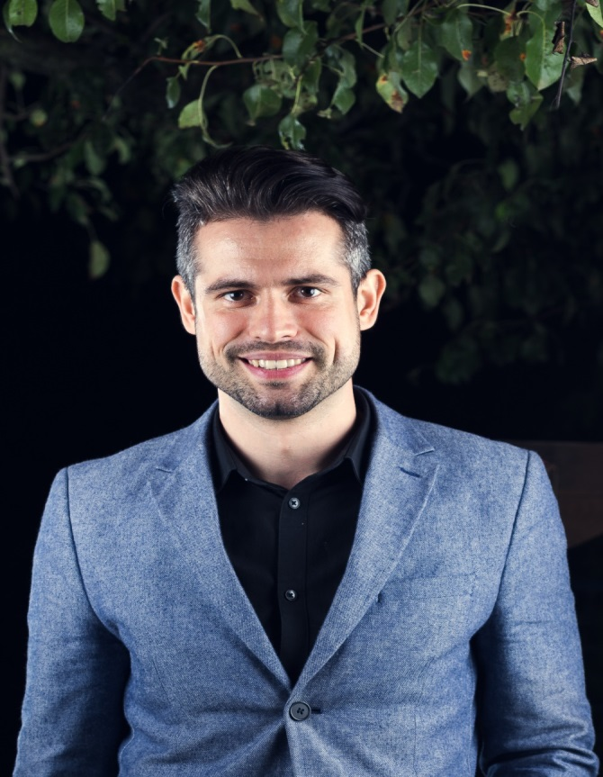
Ivaylo Papazov
Senior Full-Stack Developer @ Motion Software
Technical Trainer @ SoftUni
Experience in JS, C#, Node.js, React, ASP.NET MVC
TelerikAcademy Graduate

Slide 10
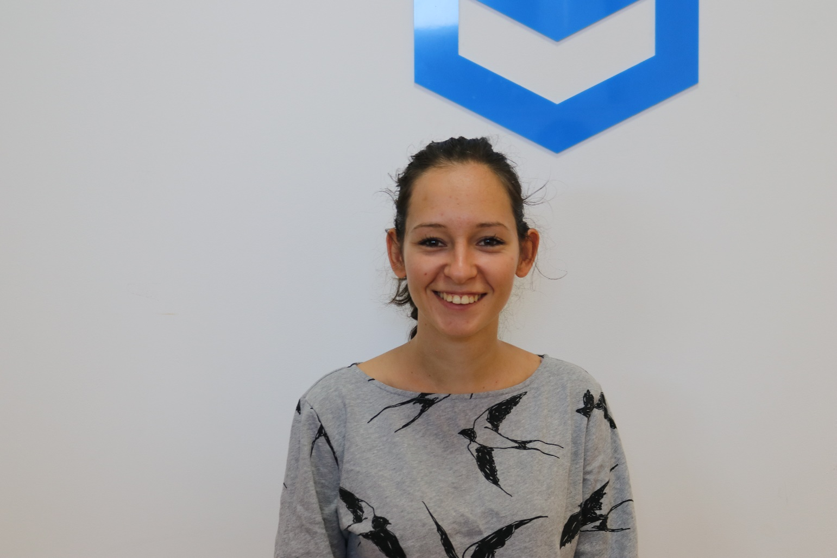
Mihaela Mileva
Experience in JavaScript, HTML, CSS, JAVA
Team Lead @ SoftUni
Currently studying Architecture in UACG
Contacts
mihaela.mileva@softuni.bg

Slide 11
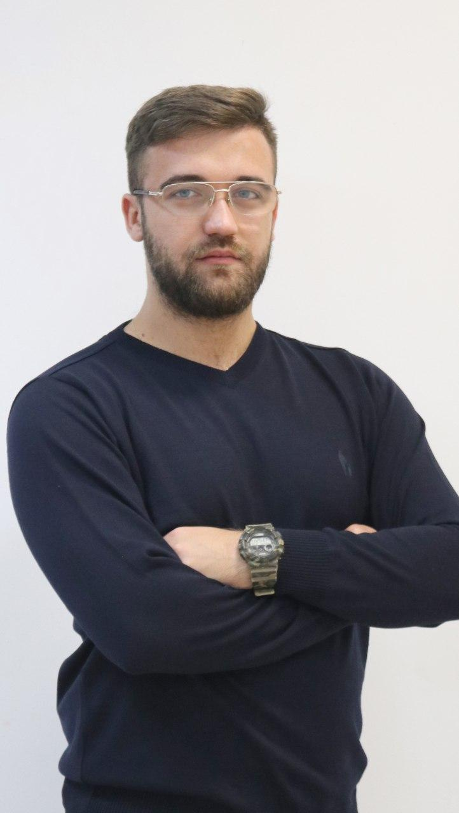
Svetoslav Dimitrov
University degree in Computer Science
Worked @ Telecommunication Company
Training Team @ SoftUni
Passionate about JS, TypeScript, Angular

Slide 12

Course Organization

Slide 13
JS Fundamentals Module
15-Jan-2020
29-Feb-2020
04-Apr-2020
JS Fundamentals
12 weeks * 3 times / week
18 credits
Start: 15-Jan-2020
Mid Exam: 29-Feb-2020
Final exam: 04-Apr-2020
Re-Take Exams
Mid Exam Retake: 07-Apr-2020
Final Exam Retake : 10-Apr-2020

Slide 14

Homework Assignments & Exercises
Your homework is mainly work in class
Lesson days → slides + live demos + exercises
Exercise days → only exercises
How to submit your homework?
Submitted in the judge system
Do your homework when it's due
Assignments pile up quickly

Slide 15



Scoring System for the Course
Theoretical Exam 5%
Practical Exam (Final + Mid) 90%
Presence in class 5%
Evaluation
Homework 5 %
15

Slide 16



Course Web Site, Forum
Official web site:
Official discussion forum:
Official SoftUni JavaScript Community:
https://softuni.bg/js-fundamentals
softuni.bg/forum/programming-fundamentals
facebook.com/groups/SoftUniJavaScriptCommunity/

Slide 17
Questions?
Notes:
17

Slide 18












SoftUni Diamond Partners

Slide 19




SoftUni Organizational Partners

Slide 20
Trainings @ Software University (SoftUni)
Software University – High-Quality Education, Profession and Job for Software Developers
softuni.bg, softuni.org
Software University Foundation
softuni.foundation
Software University @ Facebook
facebook.com/SoftwareUniversity
Software University Forums
forum.softuni.bg
20
Notes:
20

Slide 21

License
This course (slides, examples, demos, exercises, homework, documents, videos and other assets) is copyrighted content
Unauthorized copy, reproduction or use is illegal
© SoftUni – https://softuni.org
© Software University – https://softuni.bg
Notes:
21

